Slide 1

MGM Institute of Physiotherapy
Aurangabad
MAHATMA GANDHI MISSION
Didactic Lecture

Slide 2
WRIST AND HAND COMPLEX
(SPECIAL TEST)
Dr. surendra Wani
Dept. Of Musculoskeletal Physiotherapy
MGM Institute Of Physiotherapy
Chh. Sambhajinagar

Slide 3
Objectives
To understand and demonstrate the procedure for performing Wrist and hand joint special tests.

Slide 4
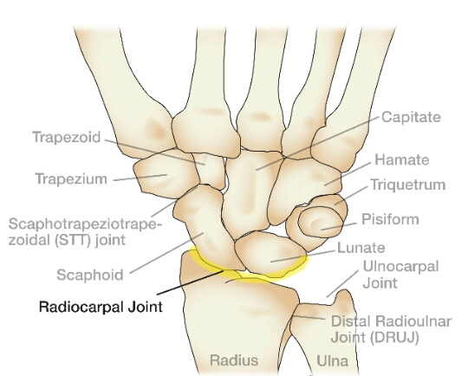

Slide 5
CONTENTS
KEY TESTS PERFORMED DEPENDING ON SUSPECTED PATHOLOGY
For ligament,capsule and joint instability
For tendons and muscles
For neurological dysfunction
For circulation and swelling

Slide 6
For ligament,capsule and joint instability
Ligamentous instability test (fingers)
The examiner stabilizes the finger with one hand opposite the joint to be tested.
With the other hand, the examiner grasps the finger distal to the joint to be tested.

Slide 7
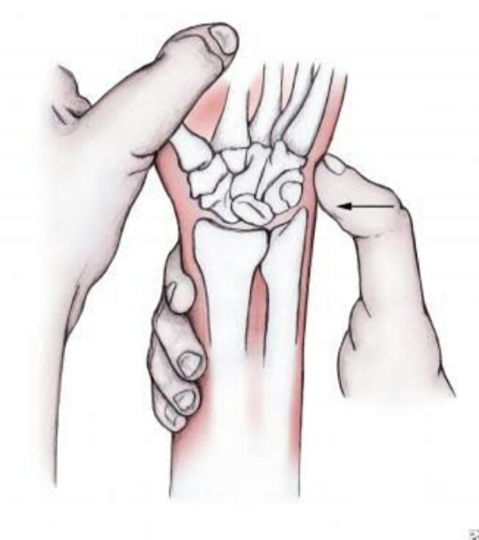
The examiner’s distal hand is then used to apply a varus or valgus stress to the joint to test the integrity of the collateral ligaments.
The results are compared for laxity with those of the uninvoived hand,which is tested first.

Slide 8
MURPHY’S SIGN
STEPS
The patient is asked to make a fist.
POSITIVE SIGN
If the head of third metacarpal is level with the the second and fourth metacarples
IT INDICATES
Lunate dislocation

Slide 9
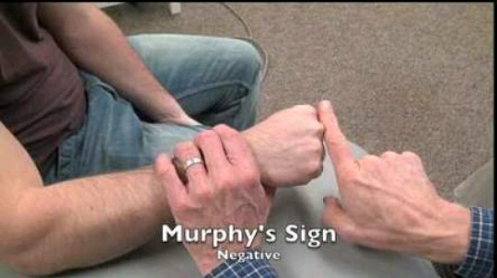

Slide 10
Thumb uinar collateral ligament laxity or instability test
The patient sits while the examiner stabilizes the patient’s hand with one hand and takes the patient’s thumb in extension with the other hand.
While holding the thumb in extension,the examiner applies a valgus stress to the MCP joint of thumb,stressing the ulnar collateral ligament and accessory ligament.

Slide 11
If the valgus movement is greater than 30 to 35 degree,it indicates complete tear of uinar collateral and accessory collateral ligament.
To test the collatreal ligament in isolation,carpometacarpal joint is flexed to 30 degree and a valgus stress is applied.
This is a test for gamekeeper’s thumb or skier’s thumb

Slide 12
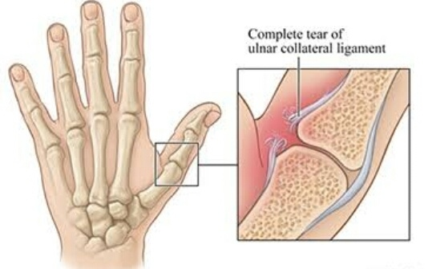

Slide 13
Triangular fibrocartilage complex load test(sharpey’s test)
The examiner holds the patient’s forearm with one hand and the patients hand with other hand.
The examiner then axially loads and ulnarly deviates the wrist while moving it dorsally and palmarly or by rotating the forearm.
Positive test-pain,clicking,or crepitus in the area of the TFCC.

Slide 14
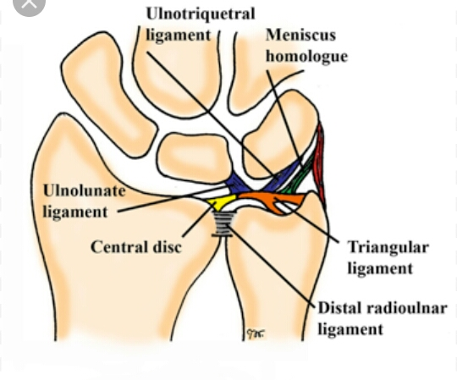
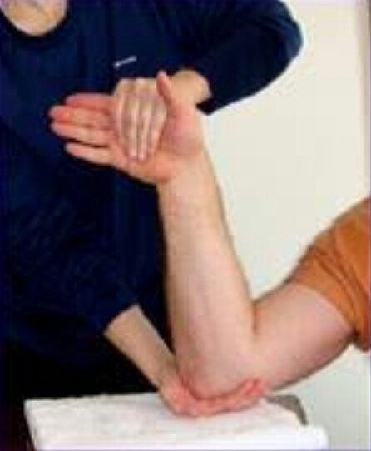

Slide 15
Watson(scaphoid shift)test
POSITION
The patient sits with the elbow resting on the table and forearm pronated.The examiner the patient.
POSITIVE TEST
If the scaphoid(and lunate)are unstable,the dorsal pole of the scaphoid subluxes or shift’s over the dorsal rim of the radius and the patient complains of pain

Slide 16
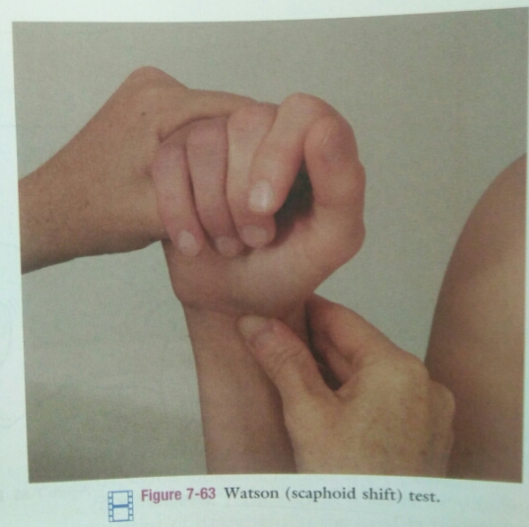
The test may also be used if scaphoid fracture is suspected.

Slide 17
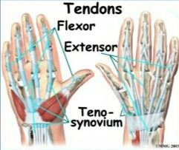
Tests for tendons and muscles

Slide 18
Finkelstein test
USES
To determine the presene of de Quervian or Hoffmann disease,a paratenonitis in the thumb.
STEPS
The patient makes a fist with the thumb inside the fingers.The examiner stabilizes the forearm and deviates the wrist toward uinar side.

Slide 19
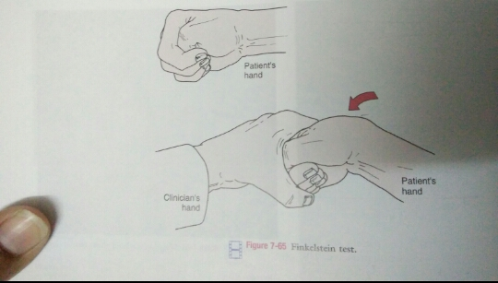
POSITIVE TEST
Pain over abductor pollicis longus and extensor pollicis brevis tendons at the wrist and indicates paratenonitis of these two tendons.

Slide 20
Tests for neurological dysfunction
Tests for neurological dysfunction are highly suggestive of a particular nerve lesion if they are positive,but they do not rule out the problem if they are negative.Infact they are negative in 50% of cases.

Slide 21
Carpal compression test
STEPS
The examiner holds the supinated wrist in both hands and applies direct,even pressure over the median nerve in the carpal tunnel for up to 30 sec.
POSITIVE TEST
Pain-carpal tunnel syndrome
This test is a modification of reverse phalen’s test

Slide 22
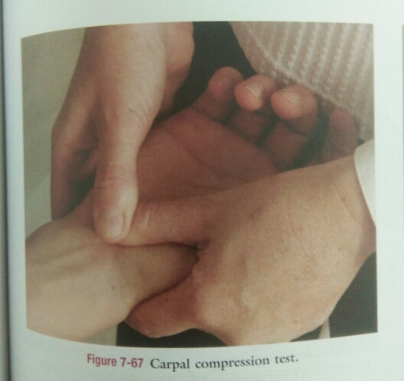

Slide 23
Forment’s ‘paper’ sign
STEPS
The patient attempts to grasp a piece of paper between the thumb and index finger.When the examiner attempts to pull the paper away
POSITIVE TEST
The terminal phalanx of the thumb flexes because of paralysis of adductor pollicis muscle

Slide 24
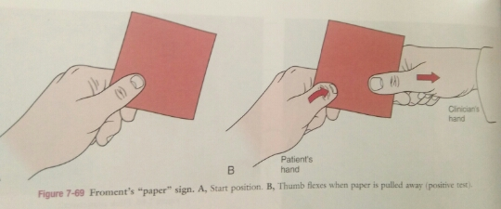
POSITIVE JEANNE’S SIGN-
If at the same time,the MCP joint of the thumb hyperxetends
UINAR NERVE PARALYSIS
Both test positive

Slide 25
Phalen’s(wrist flexion) test
STEPS
The examiner flexes the patient’s wrist maximally and holds this position for 1 min by pushing the patient’s wrist together.
POSITIVE TEST
Tingling in the thumb,index finger,and middle and lateral half of the ring finger

Slide 26
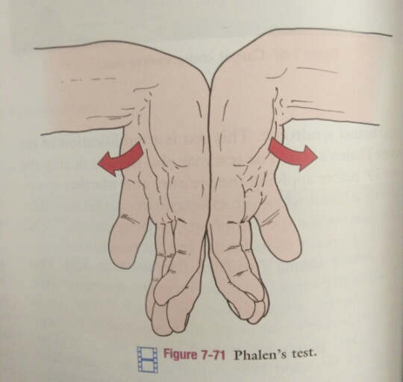
IT INDICATES
Carpel tunnel syndrome caused by pressure on median nerve.

Slide 27
Reverse phalen’s(prayer’s)test
STEPS
The patient puts both hands together and brings the hand down towards the waist while keeping the palms in full contact,causing extension of the wrist.
POSITIVE TEST
Same symptoms as those seen in phalen’s test and is indicative of pathology of median nerve.

Slide 28
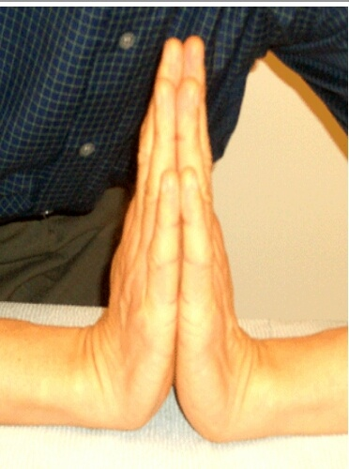

Slide 29
Tinel sign(at the wrist)
PATIENT POSITION-SITTING
STEPS
The examiner taps over the carpal tunnel at the wrist.
POSITIVE TEST
Tingling or paraesthesia into the thumb,index finger,middle and lateral half of ring finger.

Slide 30
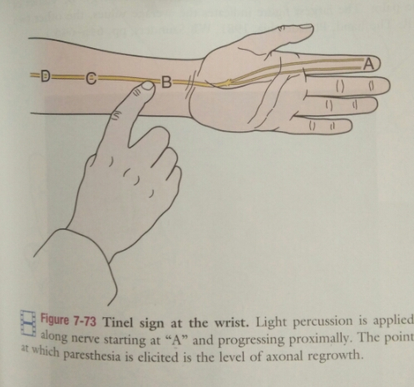
Tinnel sign at the wrist is indicative of carpal tunnei syndrome.

Slide 31
Weber’s(moberg’s)two point discrimination test
The examiner uses a paper clip,two point discriminator,or calipers
This distance is called threshold for discrimination.
Only the finger tips need to be tested.
The patients hand should be immobile on a hard surface.
Normal distance-less than 6mm

Slide 32
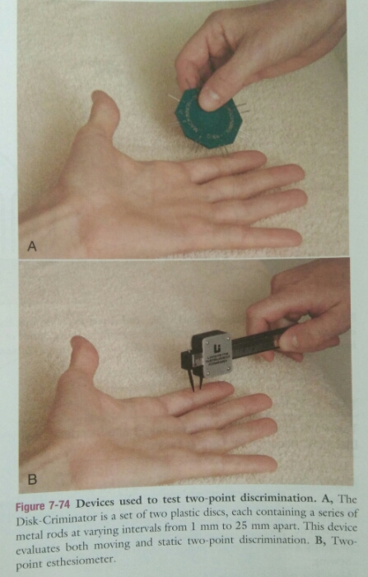

Slide 33
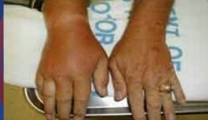
Tests for circulation and swelling

Slide 34
Allen test
This test determines the patency of the radial and ulnar arteries and determines which artery provides major blood supply to the hand.
Both hands should be tested for comparison.

Slide 35
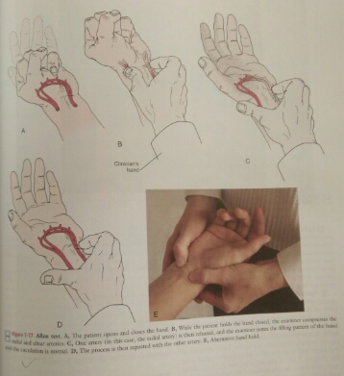

Slide 36
Figure of eight measurement
Swelling may also be measured with a tape measure.
The examiner places a mark on the distal aspect of ulnar styloid process as a starting point.
The values for both hands are compared.

Slide 37
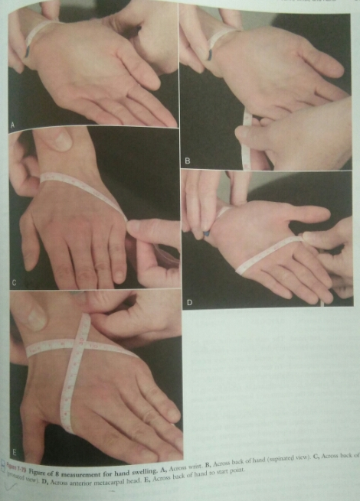

Slide 38
Summary & Questions
Allens test
Finkelsteins test
Froment sign
Tests for Carpal tunnel syndrome. 7 marks

Slide 39


